Slide 1
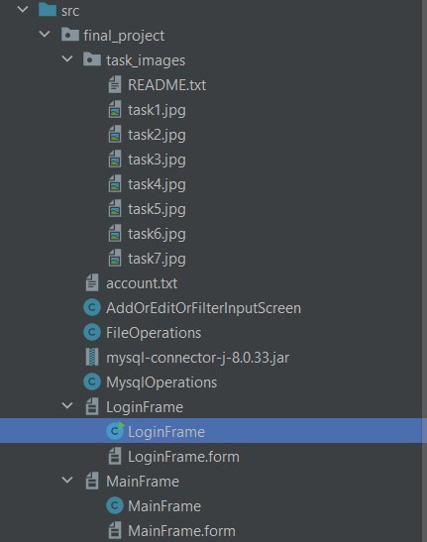
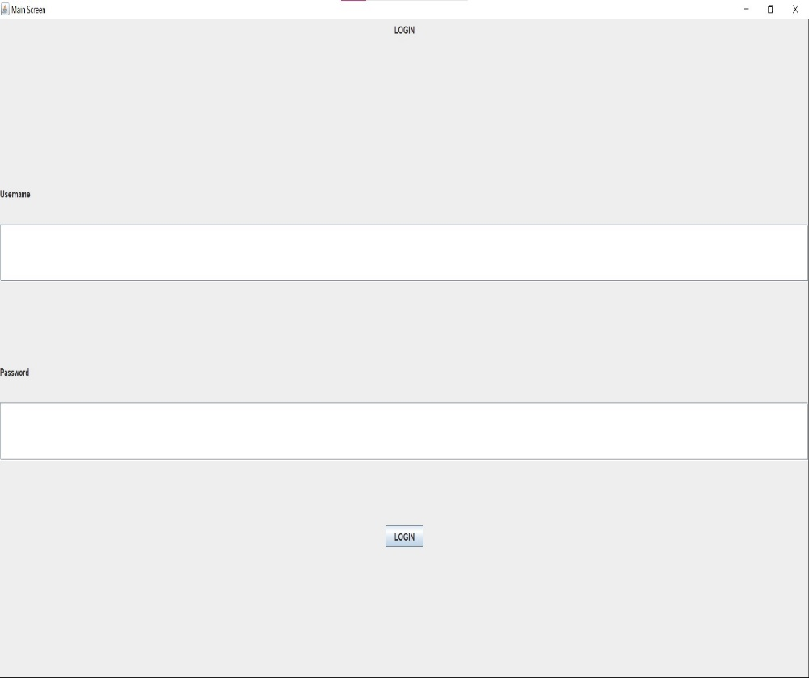
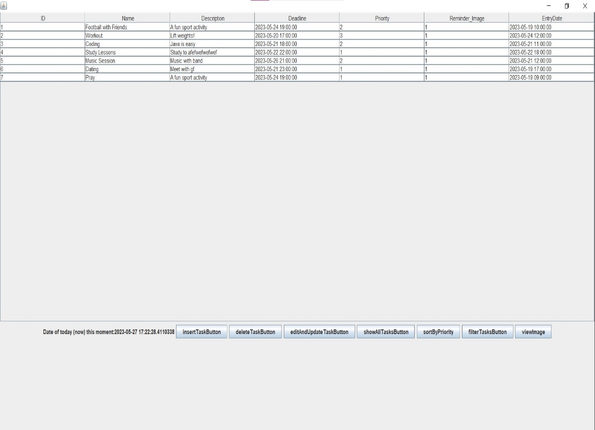
INTRODUCTION
SE 2224 PROJECT – TASK PLANNER
ARDA HARMAN - 21070006054
FILES
LOGIN SCREEN
MAIN SCREEN

Slide 2
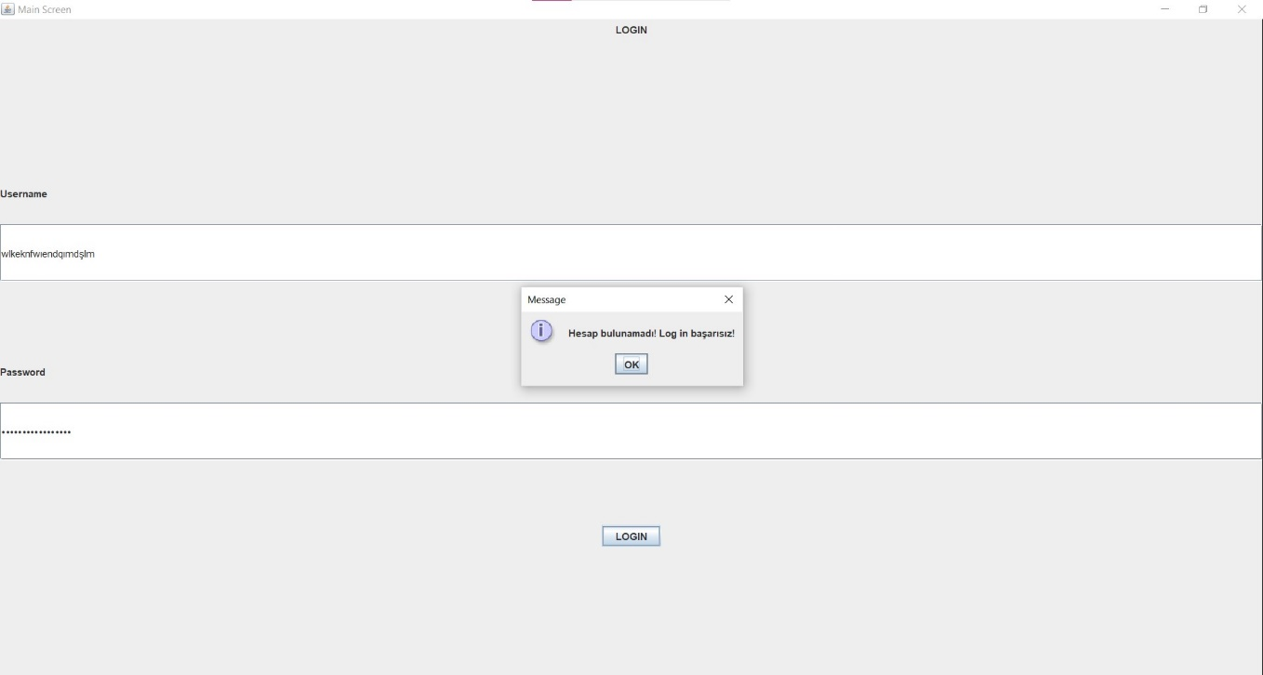
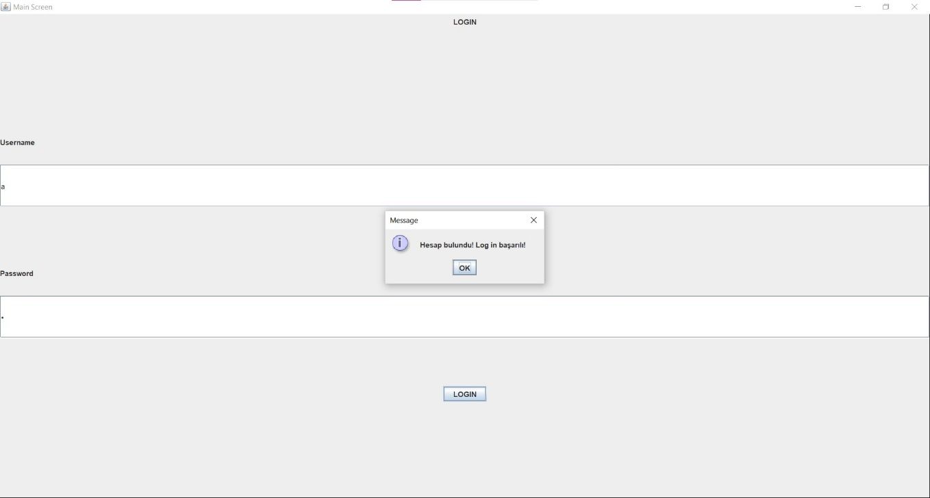
LOGIN
ATTEMPTING TO LOG IN WITH INVALID INFO
(FAILED LOGIN)
ATTEMPTING TO LOG IN WITH VALID INFO
(SUCCESSFUL LOGIN)

Slide 3
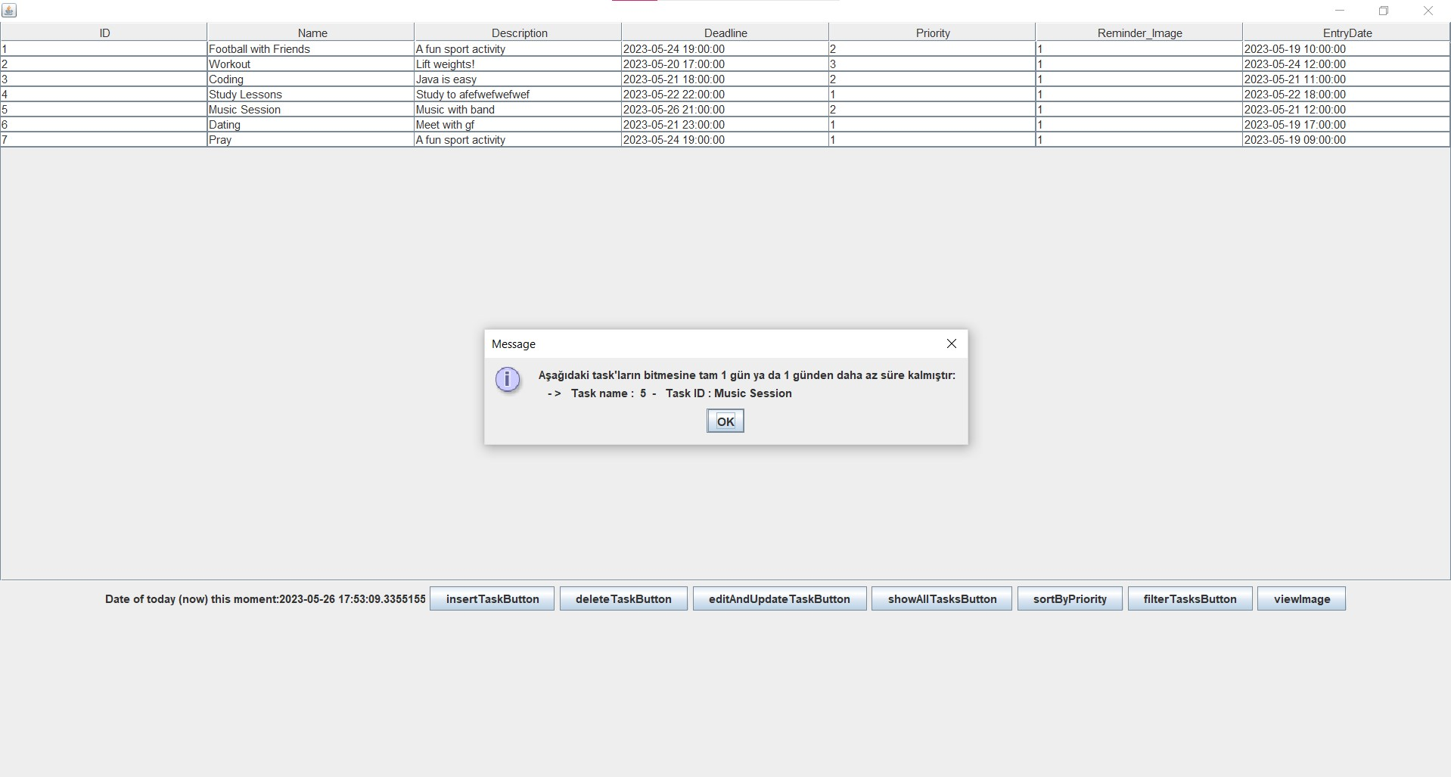
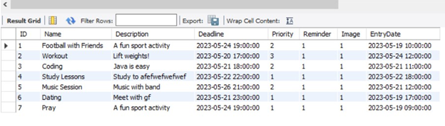
NOTIFY USER WHEN FIRST ENTERED

Slide 4
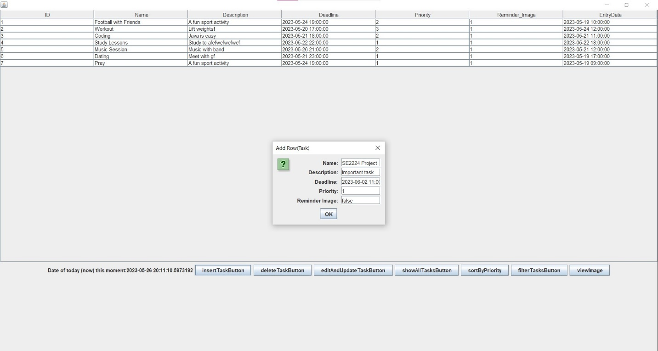
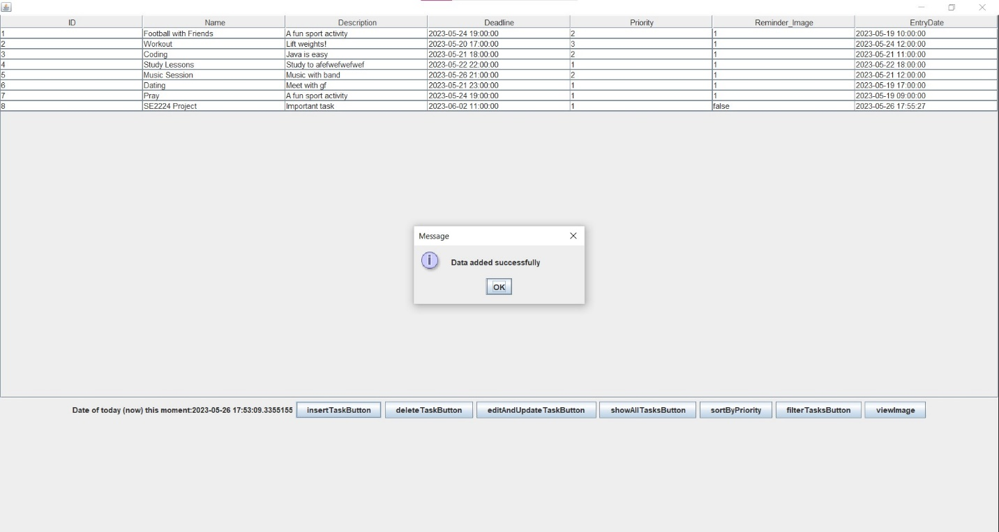
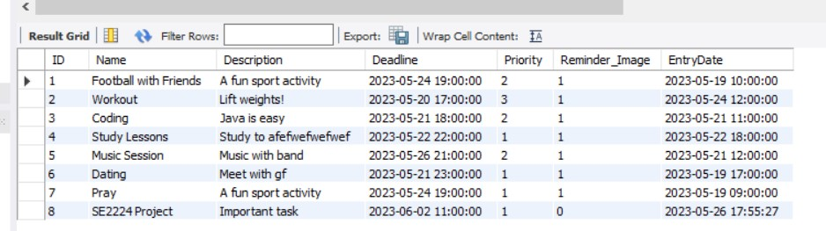
INSERT TASK

Slide 5
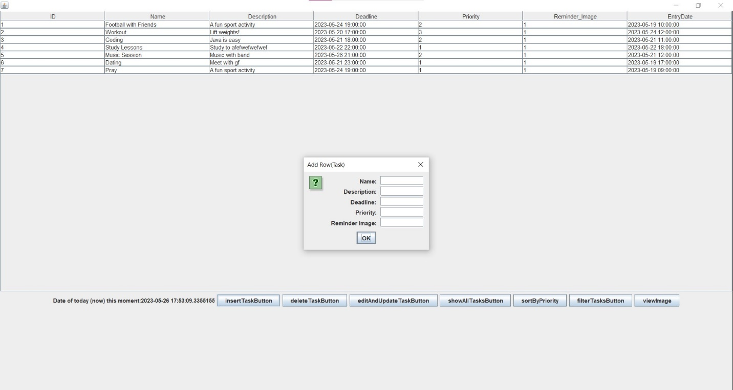

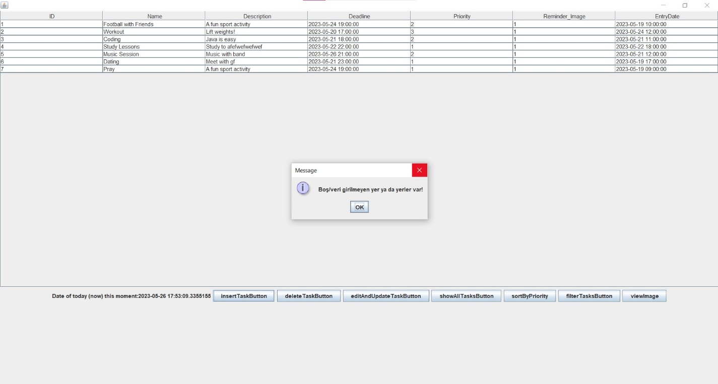
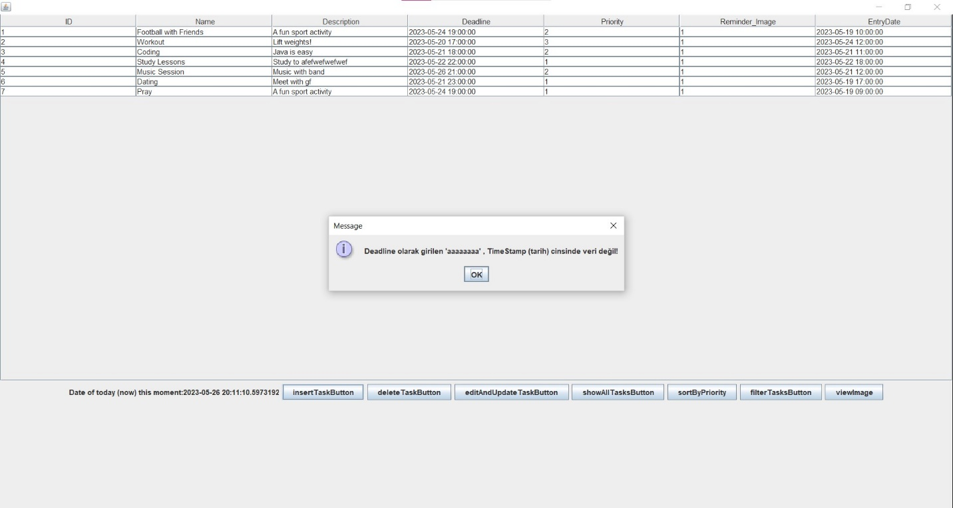
INSERT TASK
ENTERING A VALUE WHICH IS NOT A TIMESTAMP DATATYPE TO THE DEADLINE AREA
ENTERING EMPTY VALUES

Slide 6
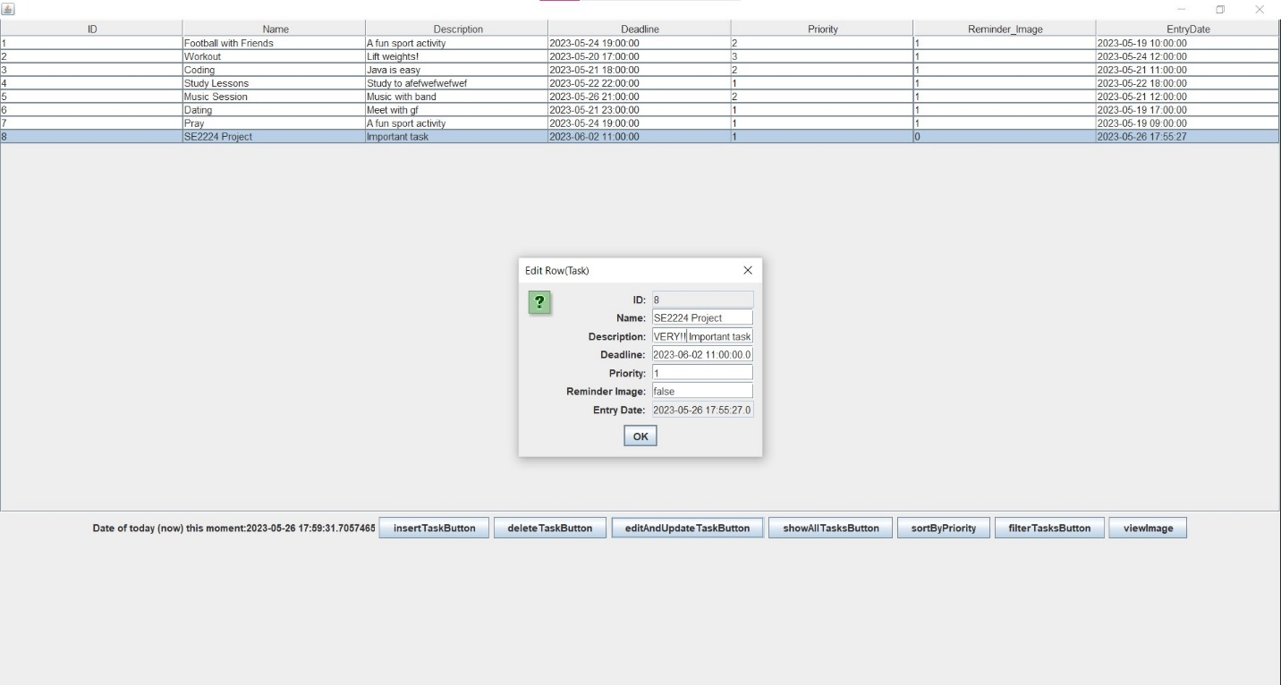
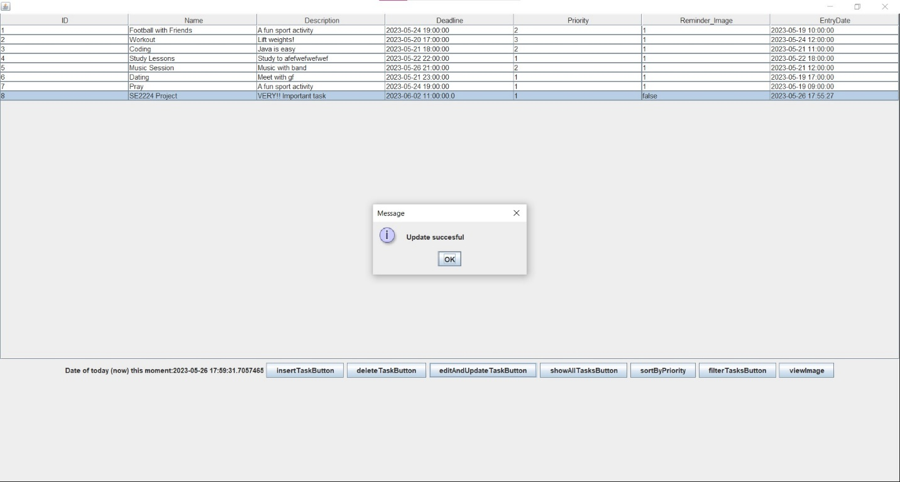
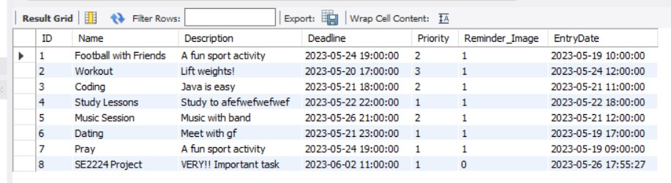
EDIT AND UPDATE TASK

Slide 7
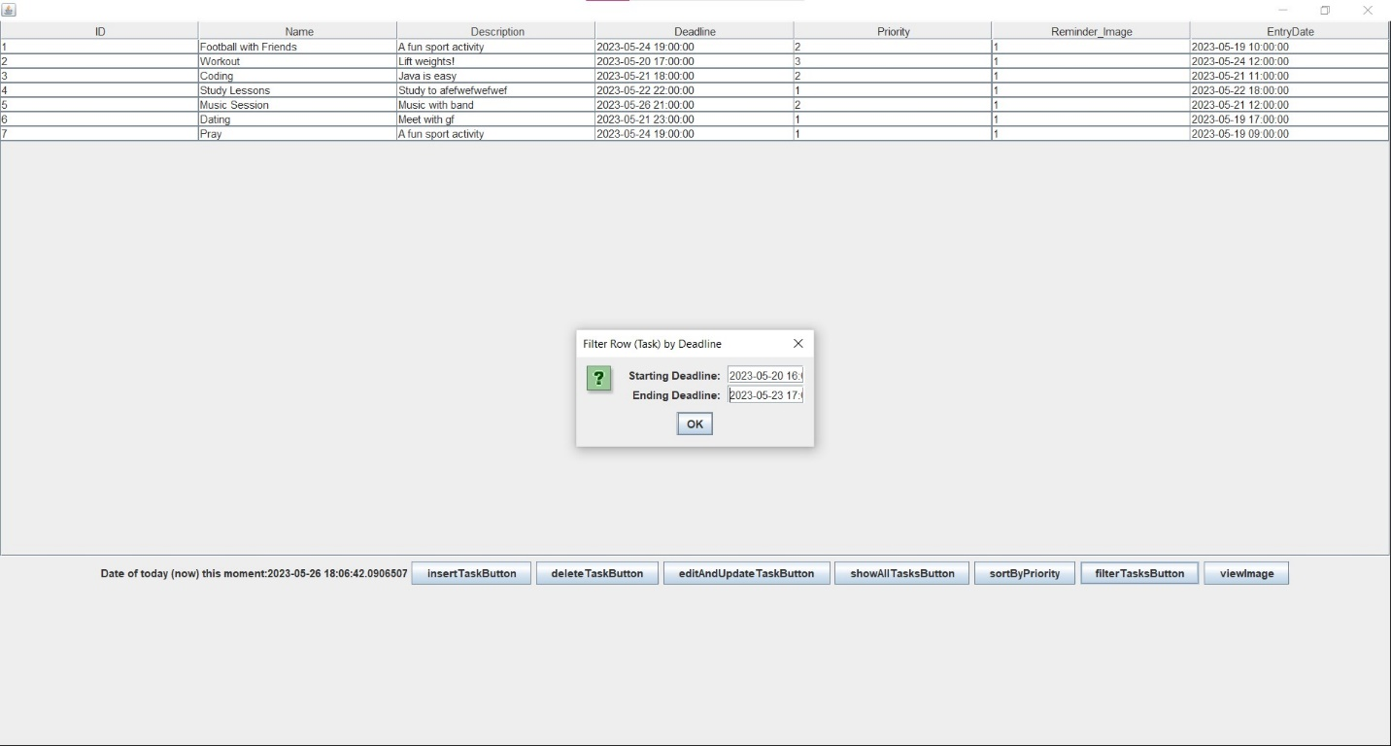
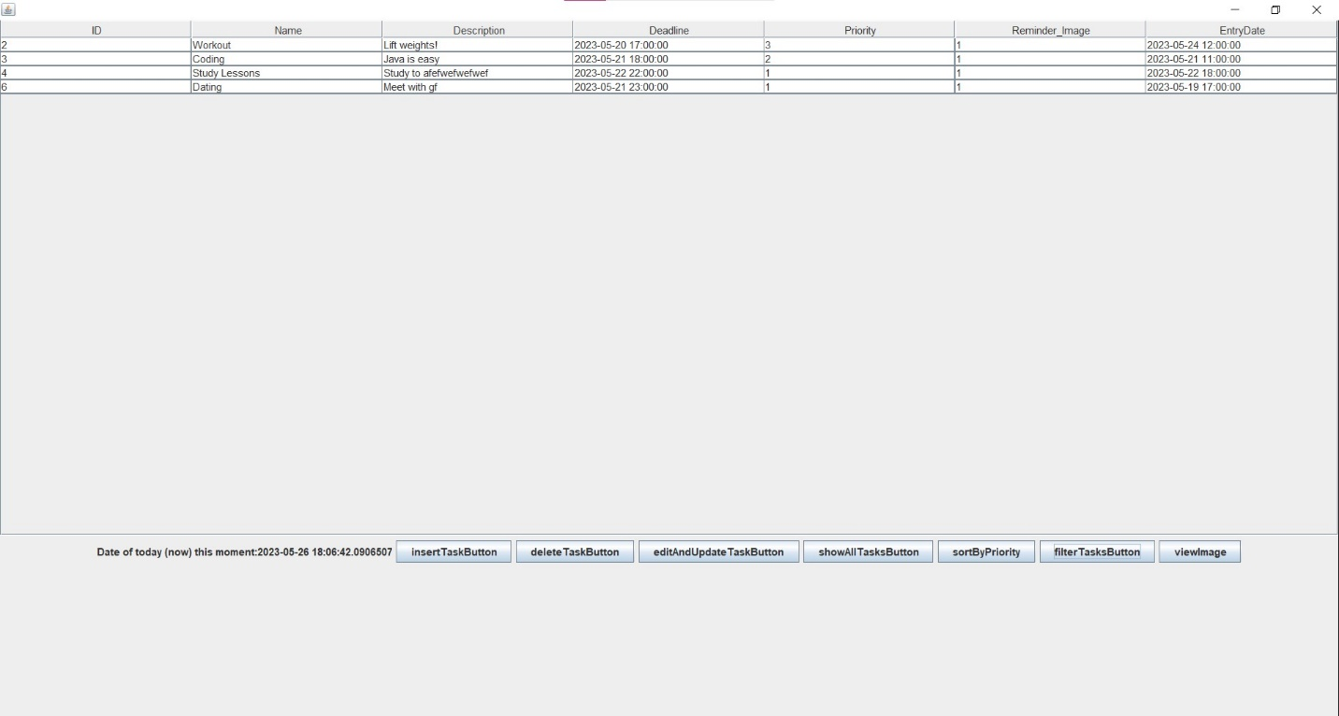
DISPLAY TASKS WHICH ARE BETWEEN START AND END DATES

Slide 8
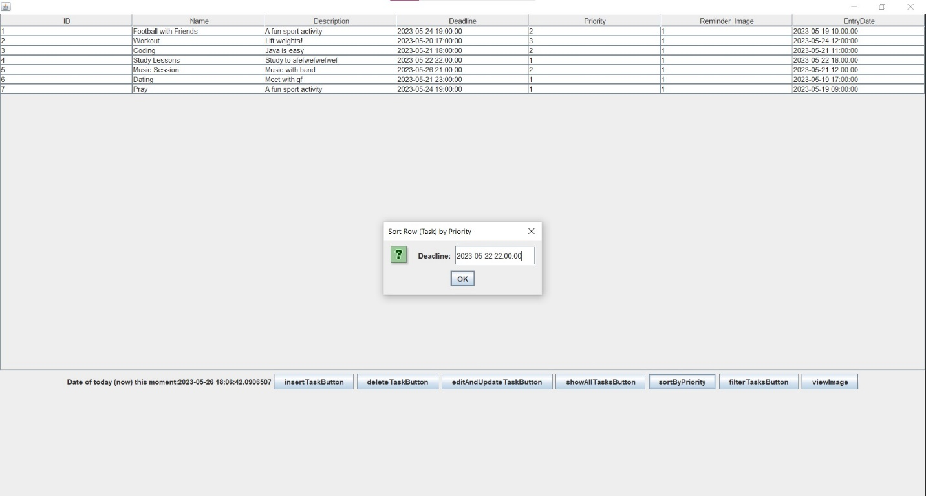
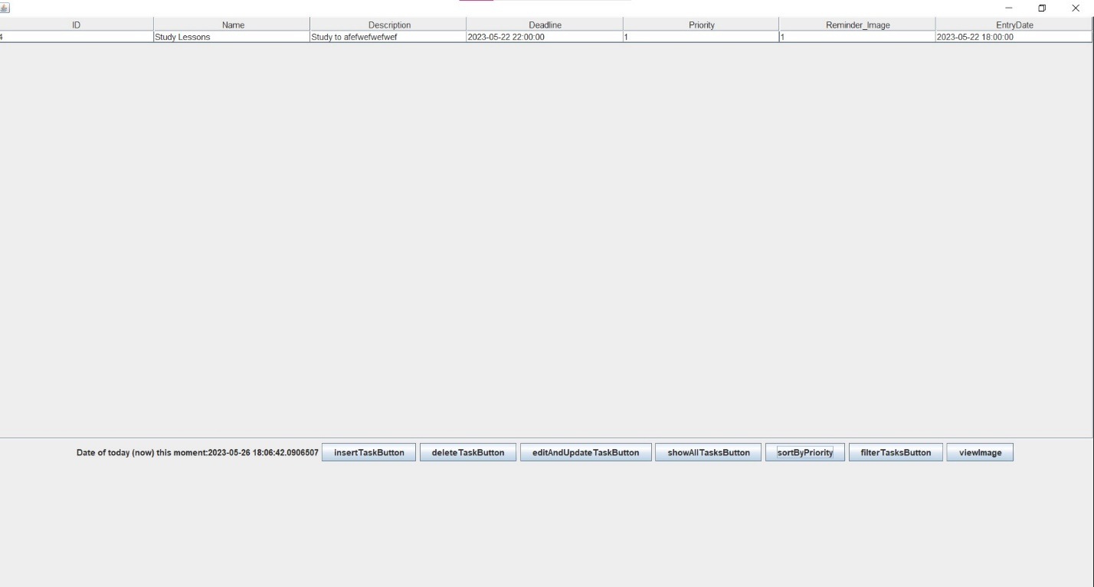
ORDER TASK WHICH HAS THE SAME DEADLINE RESPECT TO THEIR PRIORITY

Slide 9
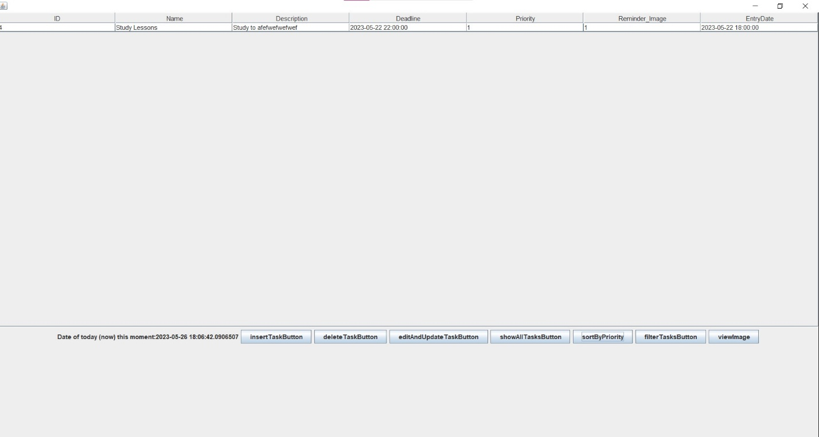
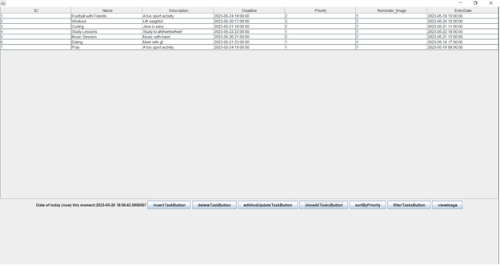
SHOW ALL TASKS

Slide 10
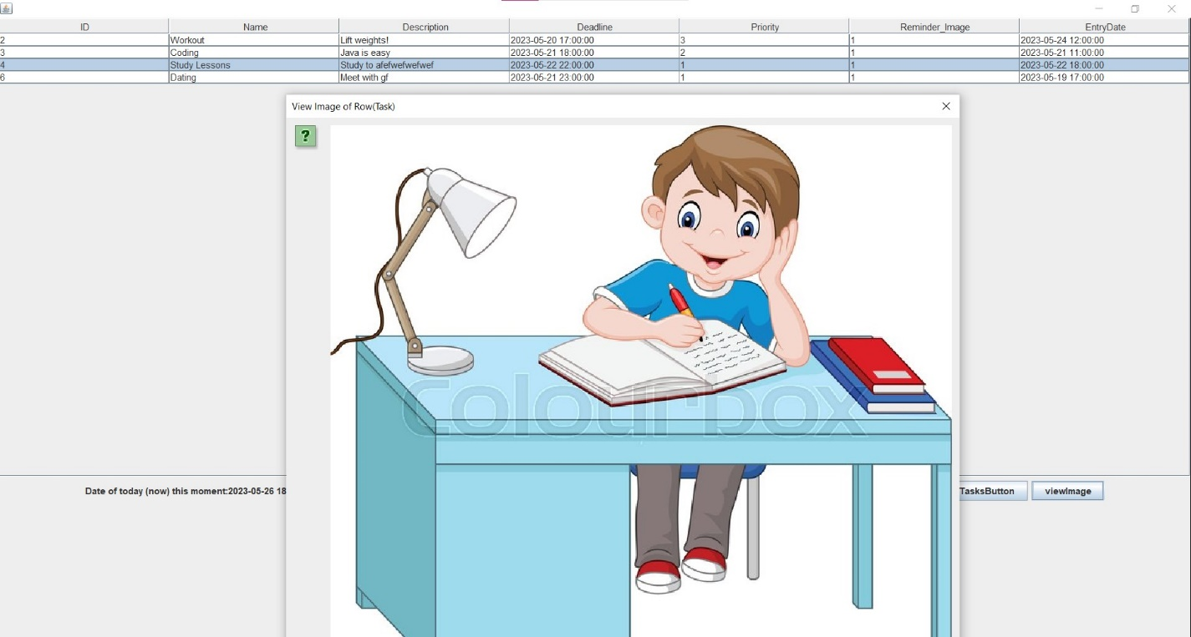
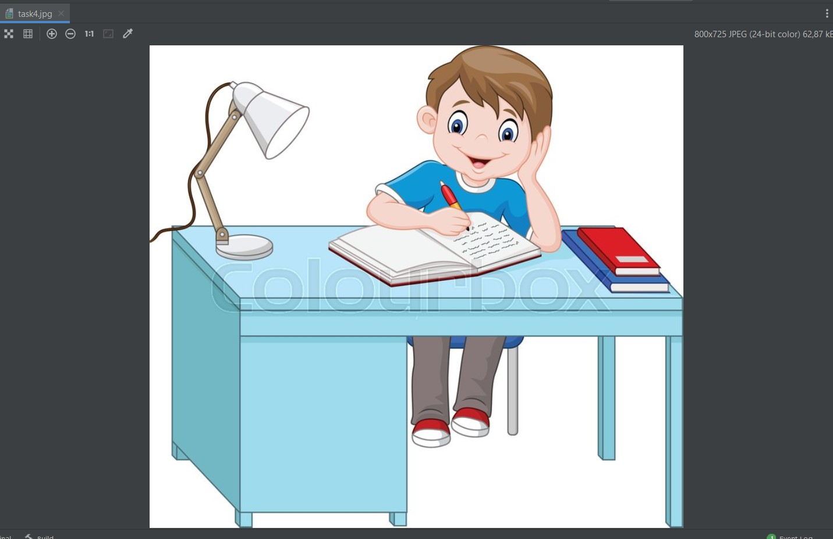
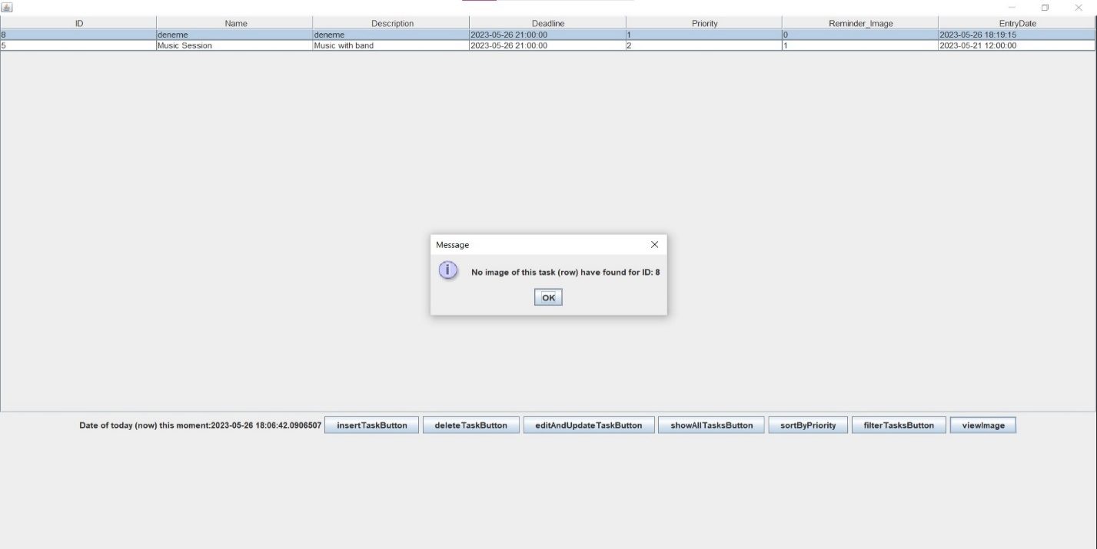
VIEW REMINDER IMAGE
SELECTED TASK HAS A REMINDER IMAGE
SELECTED TASK DOES NOT HAVE A REMINDER IMAGE

Slide 11
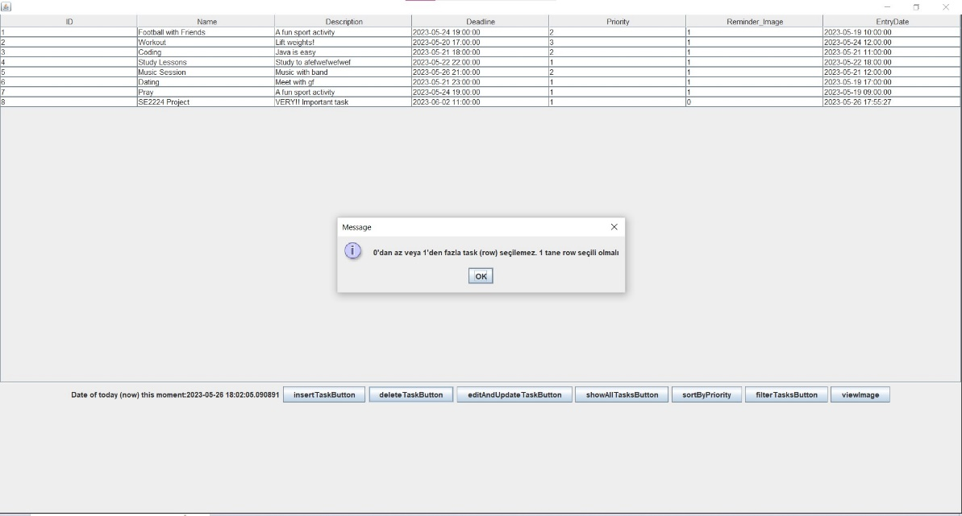
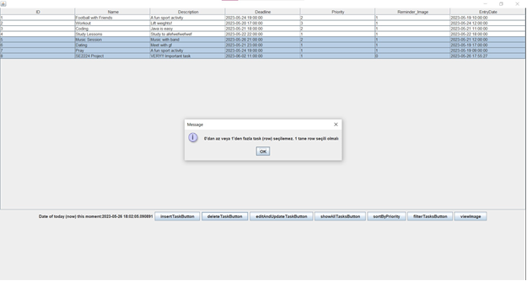
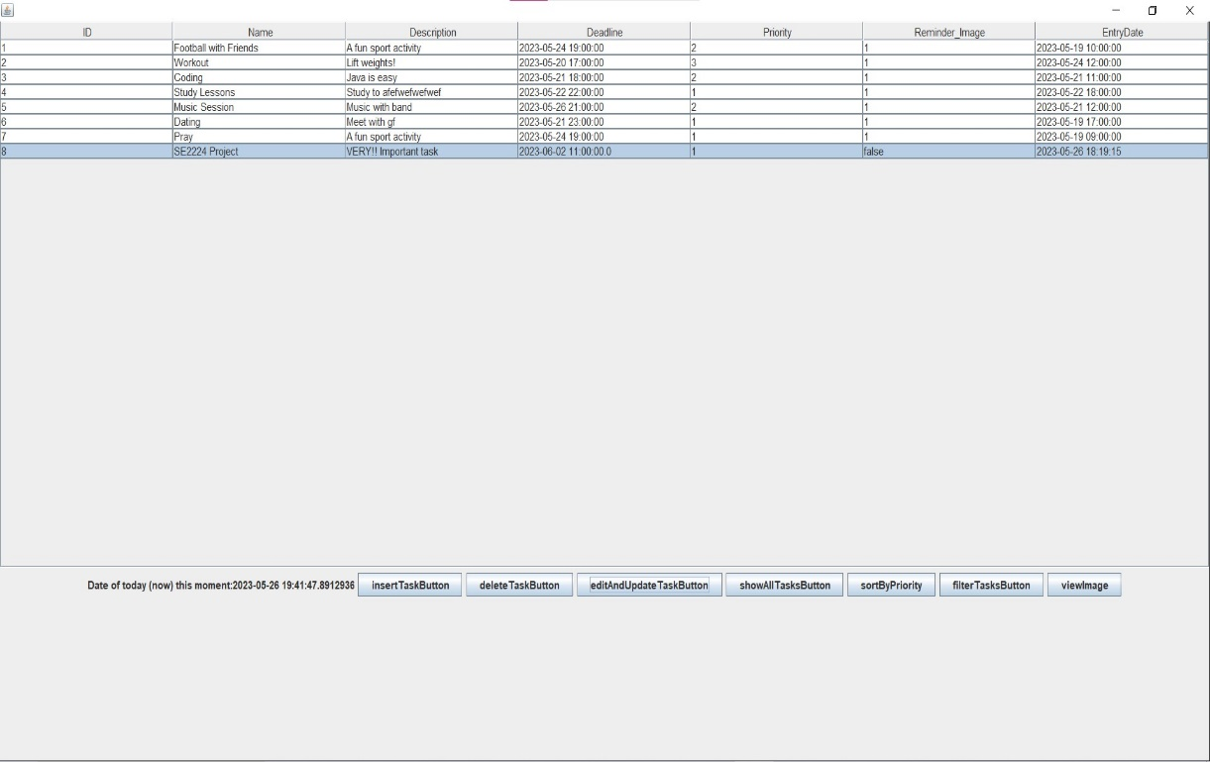

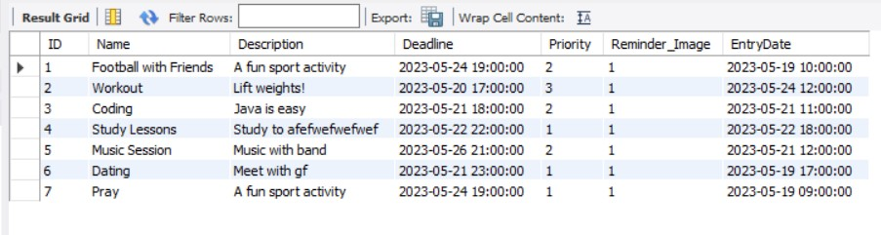
DELETE TASK
NOT SELECTING ANY ROWS TO DELETE
SELECTING MORE THAN 1 ROWS TO DELETE
SUCCESFULLY DELETING A TASK

Slide 12
OUTLINE
SUMMARY
FEATURES COULD BE ADDED

